Slide 1

Tongue Drum
Midterm Presentation
Elif Gündoğan, Samed Bayer & Yavuz Özbek

Slide 2

Outline
Problem Definition
Sound Perception
Analysis of Tongue Drums
Acoustic Analysis
Structural Analysis
Benchmarking
Cost Analysis
Gantt Chart
References
ME492 - TONGUE DRUM

Slide 3
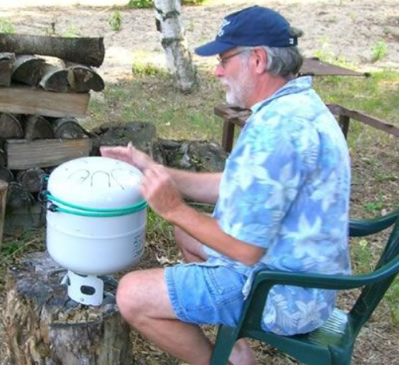
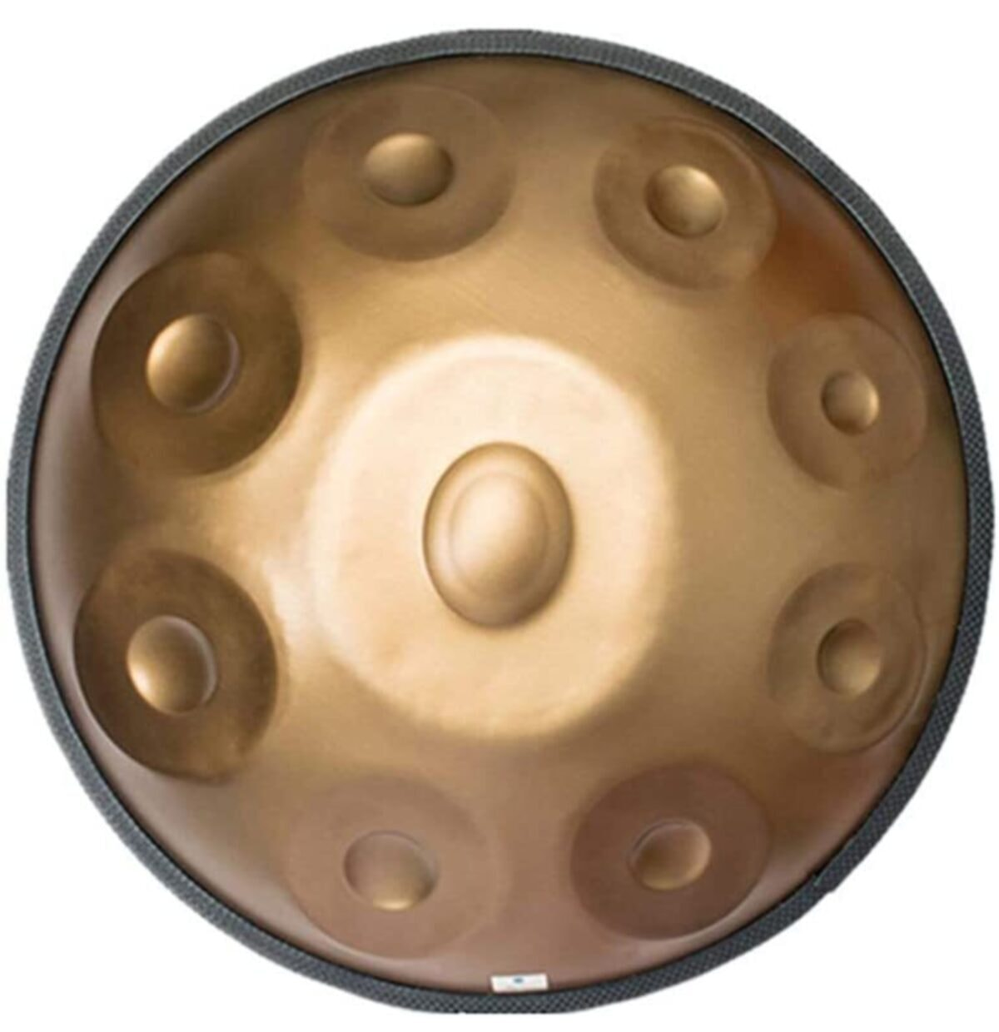
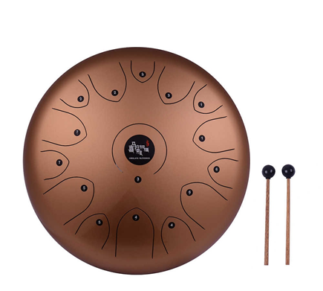
History
Dennis Havlena imitates the expensive and difficult to produce Hang Drum form a propane tank.
He uploads the instruction for the “hank drum” on the internet for free usage.
[3]
[1]
[2]
ME492 - TONGUE DRUM
Notes:
ref1: https://www.amazon.com/dp/B07VDDHK9C/ref=cm_sw_r_pi_dp_x_xaObFbRQ17X60
ref 2 adam : http://www.oddmusic.com/gallery/hank-drum.html

Slide 4

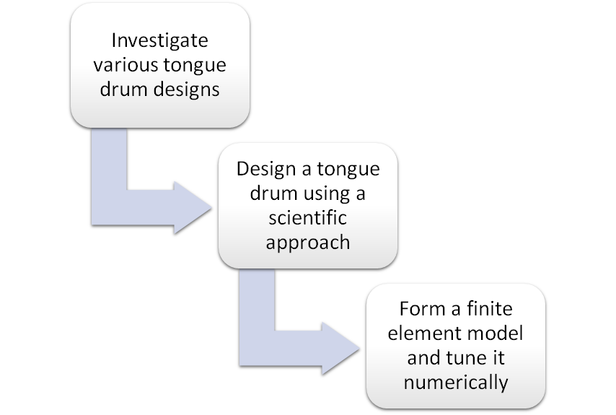
Problem Definition
[4]
ME492 - TONGUE DRUM

Slide 5
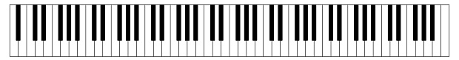
Pitch and Timbre
Pitch is a perceptual property of sounds that allows their ordering on a frequency-related scale.
[5]
La0
27.5 Hz
La4
440 Hz
Do8
4186 Hz
ME492 - TONGUE DRUM

Slide 6
Pitch and Timbre
Timbre, also known as tone color, is what makes a sound different from others, even if they have the same volume and pitch. It depends on:
Time envelope, in terms of rise, duration and decay
Spectral envelope/overtones
[6]
ME492 - TONGUE DRUM

Slide 7
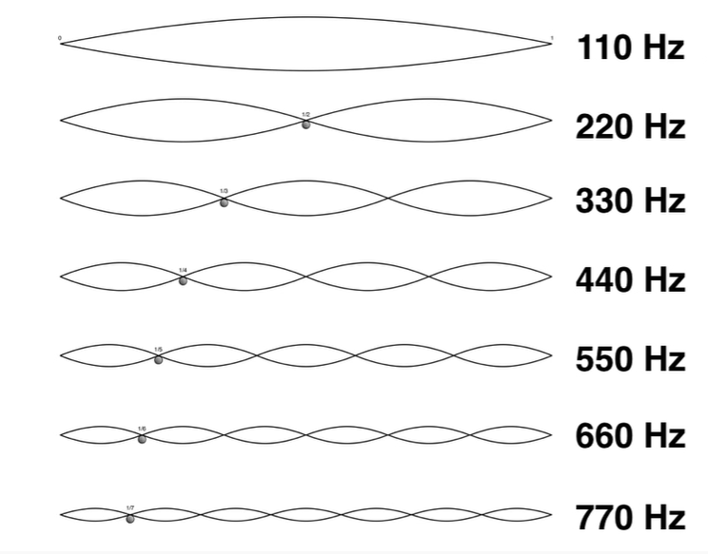
Pitch and Timbre
Acoustically, a note perceived to have a single distinct pitch in fact contains a variety of additional overtones.
Many percussion instruments, such as cymbals, tam-tams and tongue drums, create complex and inharmonic sounds.
[6]
ME492 - TONGUE DRUM

Slide 8
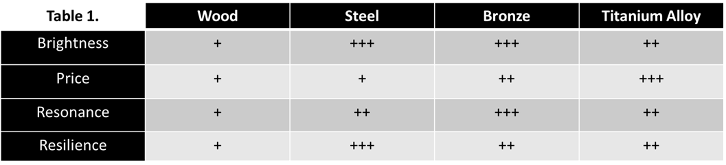
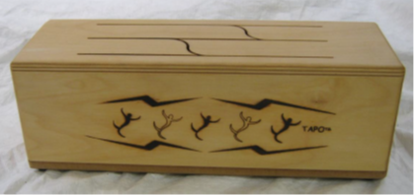
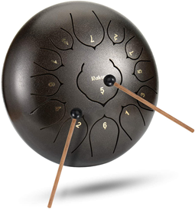
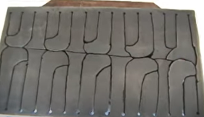
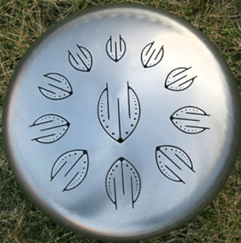

Materials
Material | Wood | Steel | Bronze | Titanium Alloy
Sound | Mellow | Bright | Bright | Bright
Price | Low | Low | Moderate | High
Resonance | Fast Decay | Resonant | Very Resonant | Resonant
Resilience | Very Low | Very High | High | High
[7]
[8]
[9]
[10]
ME492 - TONGUE DRUM

Slide 9
Materials
Material | Wood | Steel | Bronze | Titanium Alloy
Sound | Mellow | Bright | Bright | Bright
Price | Low | Low | Moderate | High
Resonance | Fast Decay | Resonant | Very Resonant | Resonant
Resilience | Very Low | Very High | High | High
[7]
[8]
[9]
[10]
ME492 - TONGUE DRUM

Slide 10
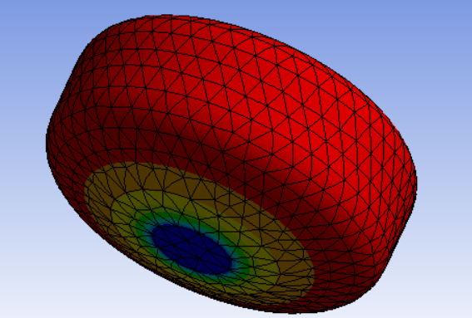
Acoustic Resonance
Air resonance of the enclosure strengthens and enriches the tone produced by hitting the tongues.
Small opening area ensures that the air resonance will be quite low.
Many acoustic modes in the frequency range of the chosen scale.
1st acoustic mode with opening: 226 Hz
ME492 - TONGUE DRUM
Notes:
The air resonance of the enclosure greatly enriches the tone, especially for the lower frequencies
The prong excites the air in the oral cavity
Air resonance from within the chamber is a factor in tongue drum tone. Tongue drum makers normally do not deliberately tune air resonances, but leave the total amount of opening area small (no large holes in the body of the drum), which ensures that the air resonance will be quite low, hopefully enhancing the bassy sound of the wood. If you make tongue drums with just one tongue, then you can consider tuning the air resonance to the tongue pitch
The tuned air resonance strengthens and enriches the tone,

Slide 11
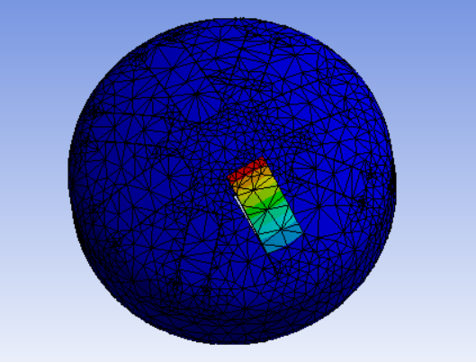
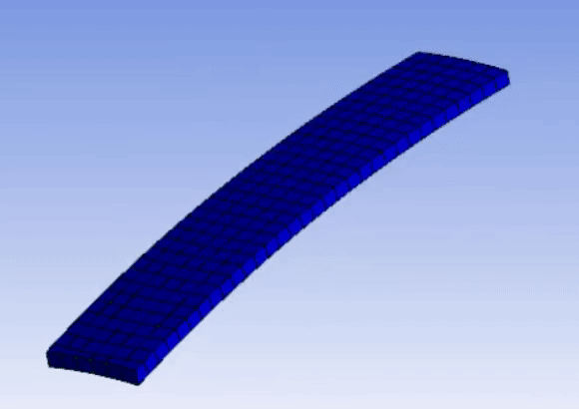
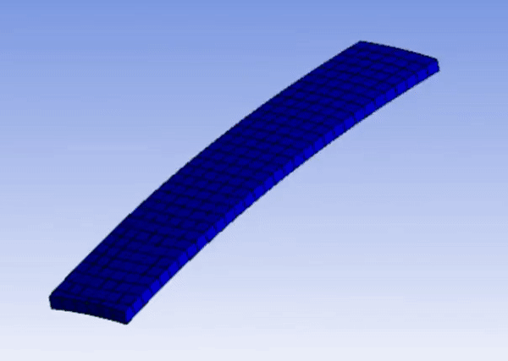
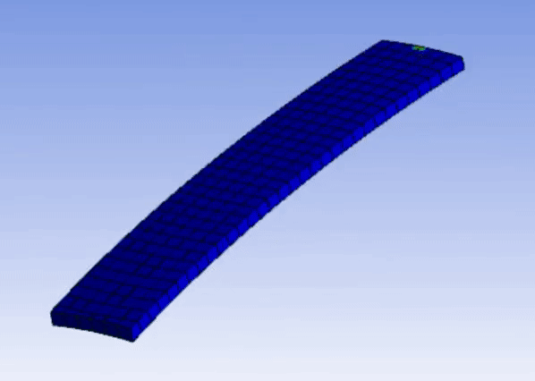
Structural Resonance
Do 4
1st mode:
259 Hz
2nd mode:
1389 Hz
3rd mode:
1594 Hz
ME492 - TONGUE DRUM

Slide 12
How to Tune?
Fundamental tuning:
If you add mass where there is a lot of motion (near the end of the tongue) you lower the frequency. You can do this by;
lengthening the tongue
sticking a mass, e.g. a magnet, to the end
If you reduce rigidity in a region where there is a lot of flex (near the base of the tongue) you lower the frequency. You can do this by;
thinning the tongue
decreasing the width of the tongue near the base
ME492 - TONGUE DRUM

Slide 13
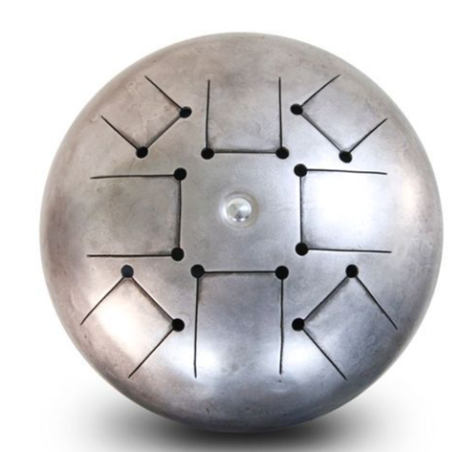
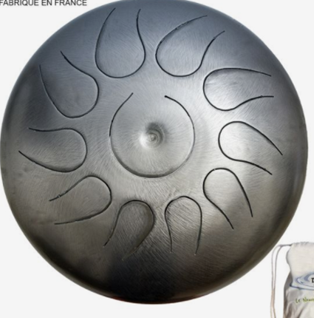
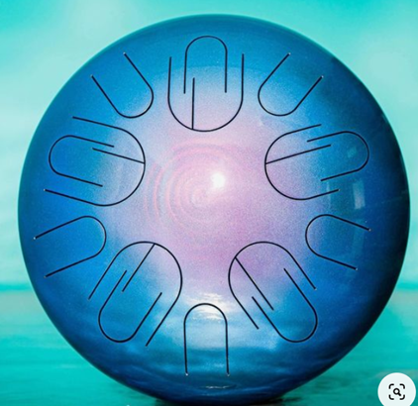
Tongue Shape
Rectangular
[11]
Rounded
[12]
Split
[13]
ME492 - TONGUE DRUM

Slide 14
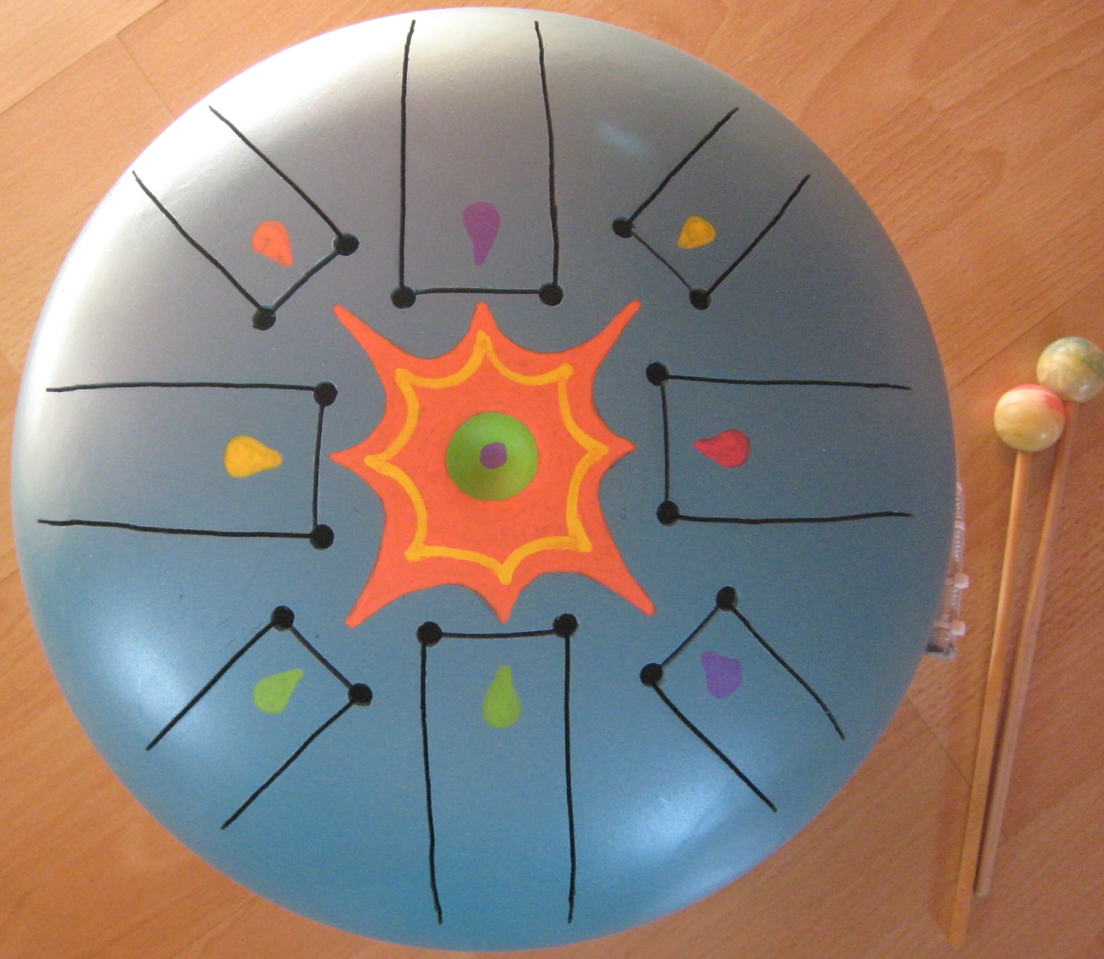
Benchmarking
20 pound propane tank
Mi minor pentatonic scale (164 - 391 Hz)
Exact dimensions and thickness
Fourier transform analysis of the recording
Acoustic and structural analysis in ANSYS
vs.
[14]
ME492 - TONGUE DRUM
Notes:
Boyle guzel olmus

Slide 15

Mi 3
163 Hz
1
Benchmarking
dB
Spectrum of the sound produced by the Mi 3 tongue.
30 dB
Structural modes
961 Hz
3
Mode | Frequency (Hz)
1 | 162,03
2 | 803,43
3 | 982,91
4 | 2067,5
5 | 2765,1
6 | 3465,9
70 Hz 2000 Hz
ME492 - TONGUE DRUM

Slide 16
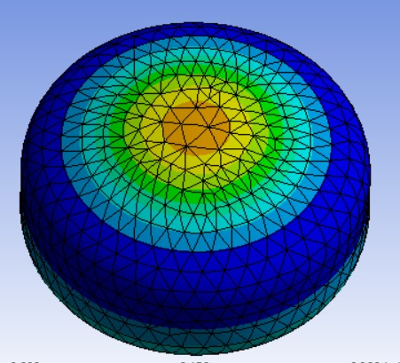
Mi 3
163 Hz
1
Benchmarking
dB
Acoustic mode
1478 Hz
961 Hz
3
1475 Hz
70 Hz 2000 Hz
ME492 - TONGUE DRUM

Slide 17
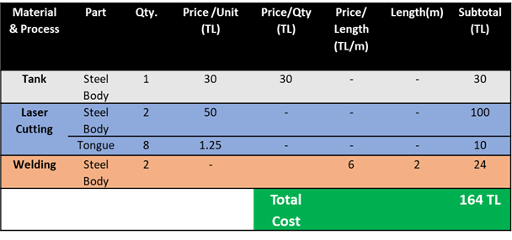
Conclusion and Cost Analysis
Perform coupled structural and acoustic analysis.
According to simulation results, optimize the design.
Manufacture the tongue drum.
ME492 - TONGUE DRUM

Slide 18
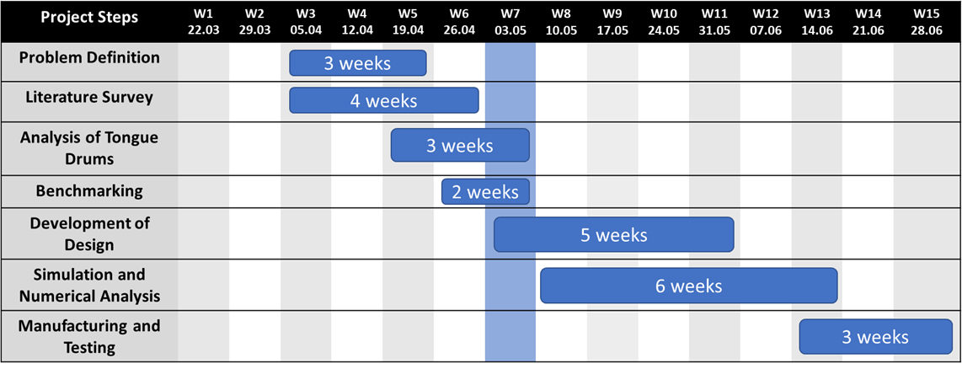
Gantt Chart
ME492 - TONGUE DRUM

Slide 19
References
https://www.amazon.com/dp/B07VDDHK9C/ref=cm_sw_r_pi_dp_x_xaObFbRQ17X60
https://tr.aliexpress.com/i/4000816875668.html
http://www.oddmusic.com/gallery/hank-drum.html
https://www.youtube.com/watch?v=2TlN_8oB6D4
https://www.istockphoto.com/tr/vekt%C3%B6r/b%C3%BCy%C3%BCk-piyano-klavye-d%C3%BCzeni-gm1164156410-319906793
https://www.youtube.com/watch?v=JsVqb6PAA1k
https://www.youtube.com/watch?v=7-QYFKyYtzY
https://www.youtube.com/results?search_query=tongue+drum+ciao+bella+cover
https://www.youtube.com/watch?v=B569Cxj_T2U
https://soundcloud.com/steel-tongues/perseus-titanium-steel-tongue-drum
https://tr.pinterest.com/pin/12736811426276435/
https://www.pinterest.cl/pin/819725569658205300/
https://www.etsy.com/listing/719497422/small-steel-tongue-drum-with-nine-notes
http://olivierbricole.canalblog.com/archives/2017/04/19/35189829.html
ME492 - TONGUE DRUM

Slide 20
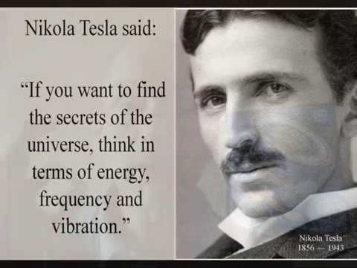
THANK YOU FOR
LISTENING
ME492 - TONGUE DRUM
Notes:
refereans : https://themmacommunity.com/threads/thy-devils-tools-how-music-is-used-to-control-the-mind-body.65659/

Slide 21
BACK UP

Slide 22
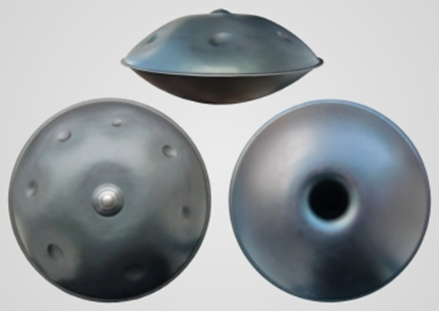
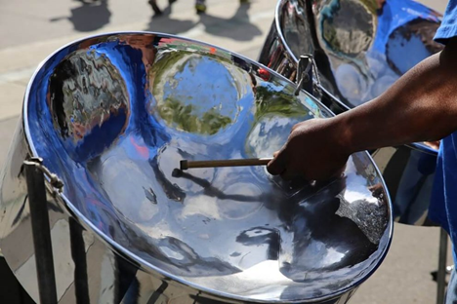
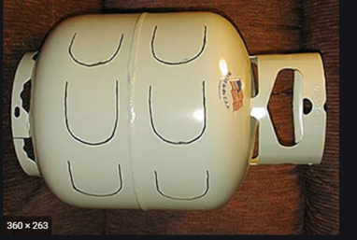
Inspirations of the Tongue Drum
Hang drum/ Handpan
Steelpan
Tambiro

Slide 23
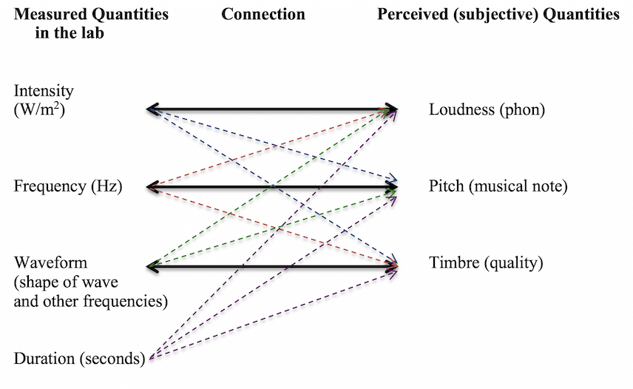
Perception of Sounds
Loudness is the human perception of sound intensity.
It is frequently measured in dB which is a scale based on the human threshold of hearing. It also is influenced by frequency and waveform of the sound.
Our ears are better at distinguishing differences in frequency at low frequencies than high.
ME492 - TONGUE DRUM

Slide 24
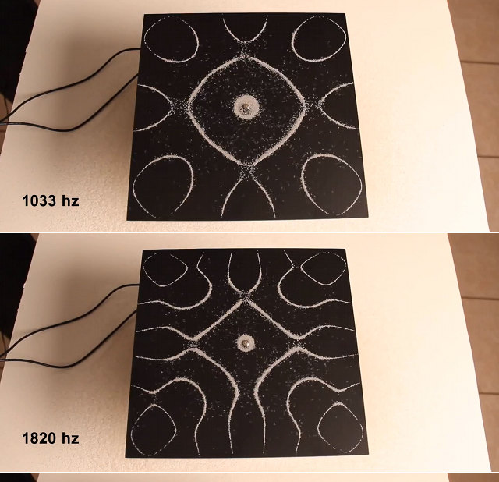
Chladni Pattern
Modes of vibration on a rigid surface known as Chladni figures due to the various shapes or geometric patterns created by various modes of the surface.
First a black metal plate is attached to a tone generator and then sand is poured on the plate.
Then, the vibration causes the sand to move and concentrate along the nodal lines where the least amount of vibration occurs.
ME492 - TONGUE DRUM
Notes:
referans : https://geekologie.com/2013/06/pretty-the-patterns-of-different-audio-f.php

Slide 25
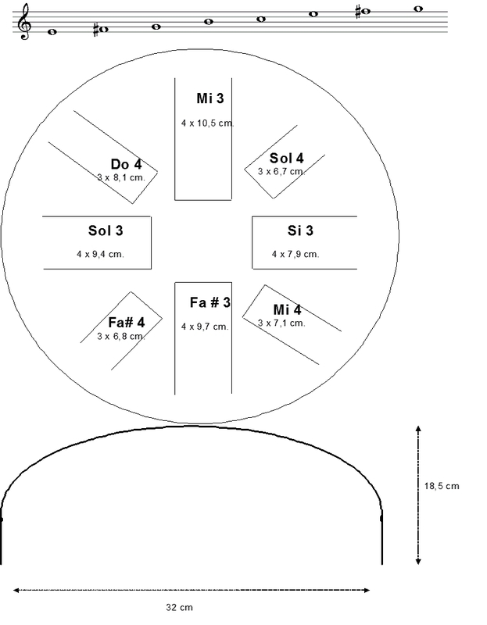
Dimensions in Benchmark
ME492 - TONGUE DRUM
Notes:
referans : https://geekologie.com/2013/06/pretty-the-patterns-of-different-audio-f.php

Slide 26
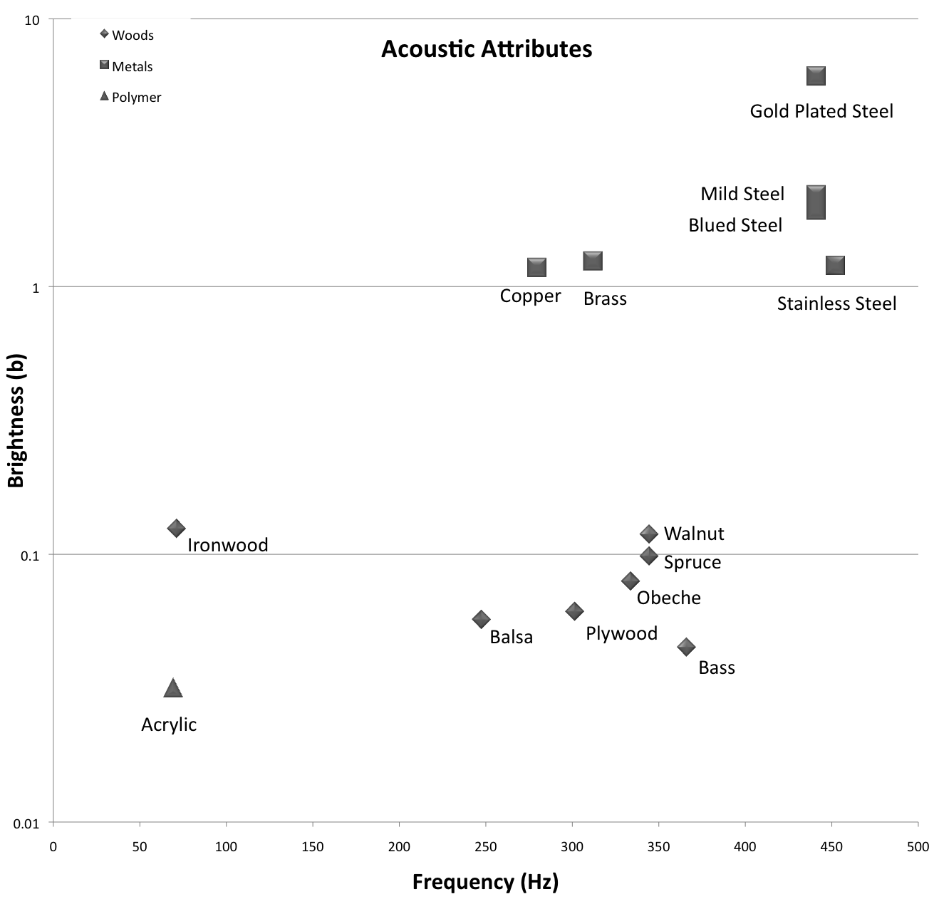
Acoustic Attributes

